Slide 1
Protection and detection of animals using IoT
Project guide :- Dr. Shahul Hamid Khan
Name:- D.Shruthi
Roll no :- MDM18B013
Internet of Things ( IoT ) :- It is a system of devices
connected to one another by transferring and receiving.

Slide 2
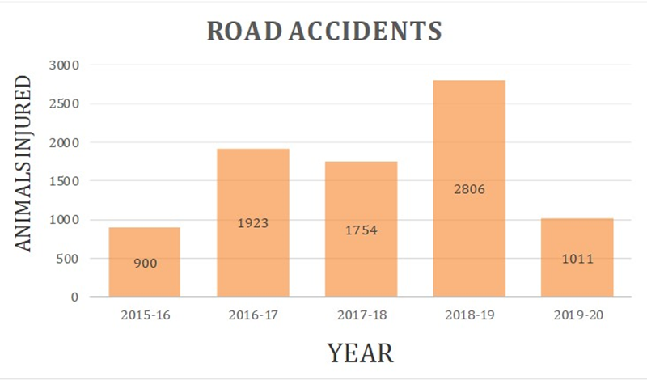
Problem statement
The main objective of this project work is to protect wild animals with the help of IoT. It can help us to fulfill our task with or without our presence.
As most of the forest land is using for our needs, animals are roaming into the roads and resulted in such a heavy task to manage. During animal vehicle collision(AVC), people might lose their properties, injured or may die at the same time animals also suffer and lives of both the humans and animals are at risk
In agricultural fields, animals enter the field and leave with much trouble to them. This can cause huge loss to farmers and they have to work even harder to protect their field.
We are trying to send those wild animals
away without causing harm to them and
also protecting animals from AVC
In this project we focussed on two parts:-
1. Safety of animals
2. Protection of crops from animals

Slide 3
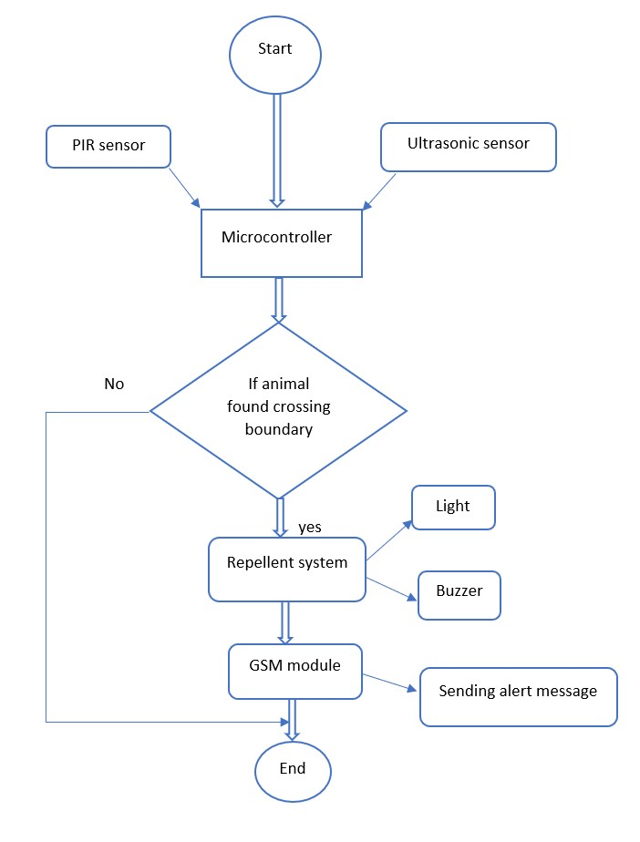
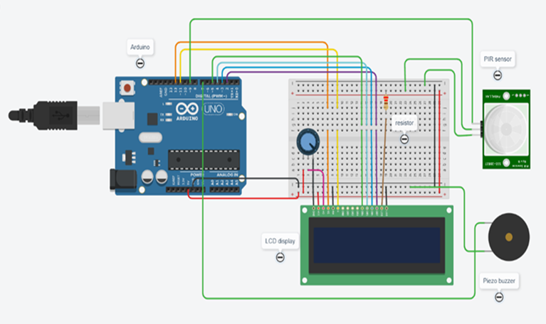
1. Safety of animals

Slide 4
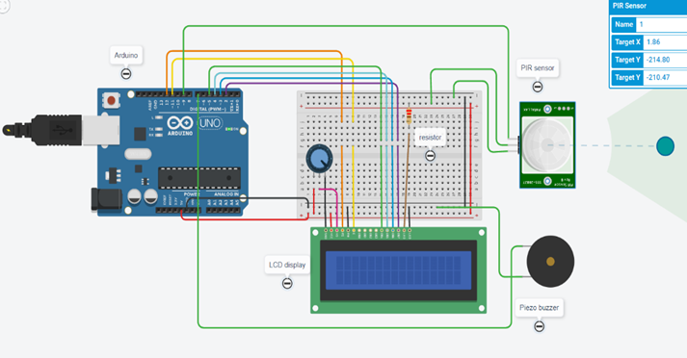
Simulation
In this circuit, we used PIR sensor to detect body’s motion And if any body comes near by or to its boundaries then buzzer will emit the sound so that they can take care of it.
STEP 1 : It tells us that the body is near boundaries to it
STEP 2 : It tells us that body is moving and nearer to you
STEP 3 : It tells us that body is nearer and it was stopped

Slide 5
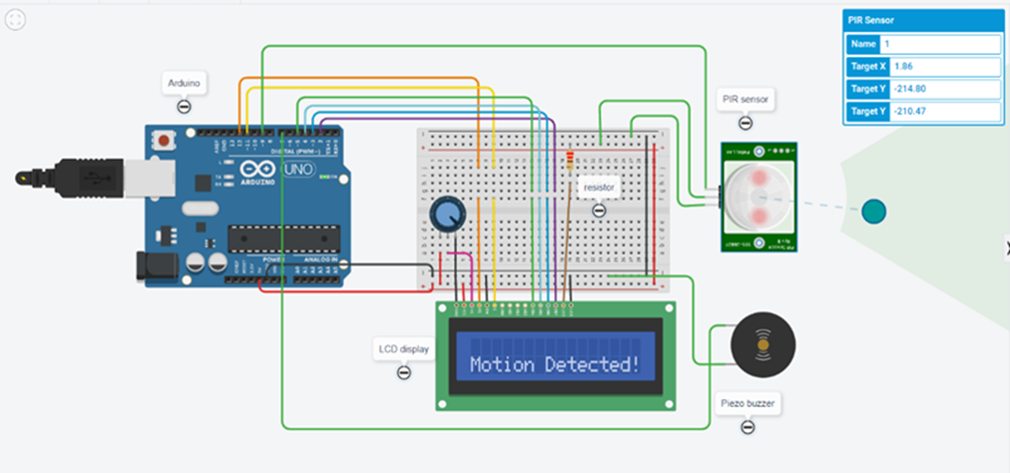
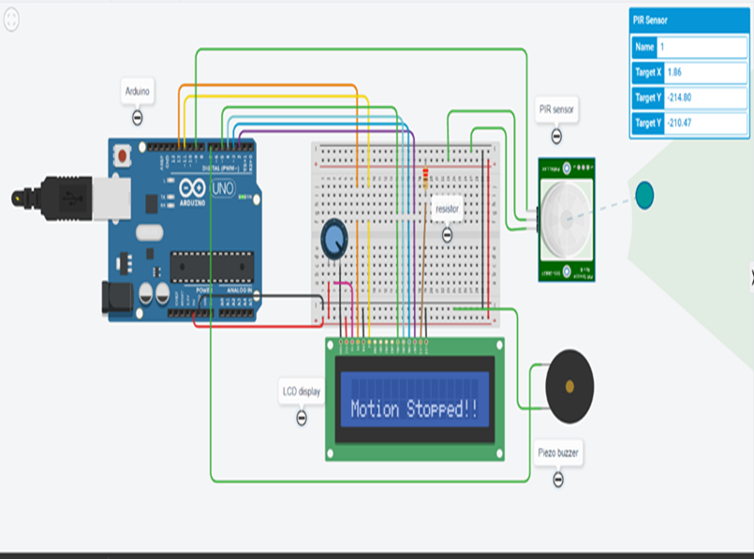
Result of simulation
Motion of the body was detected
Motion of the body stopped

Slide 6
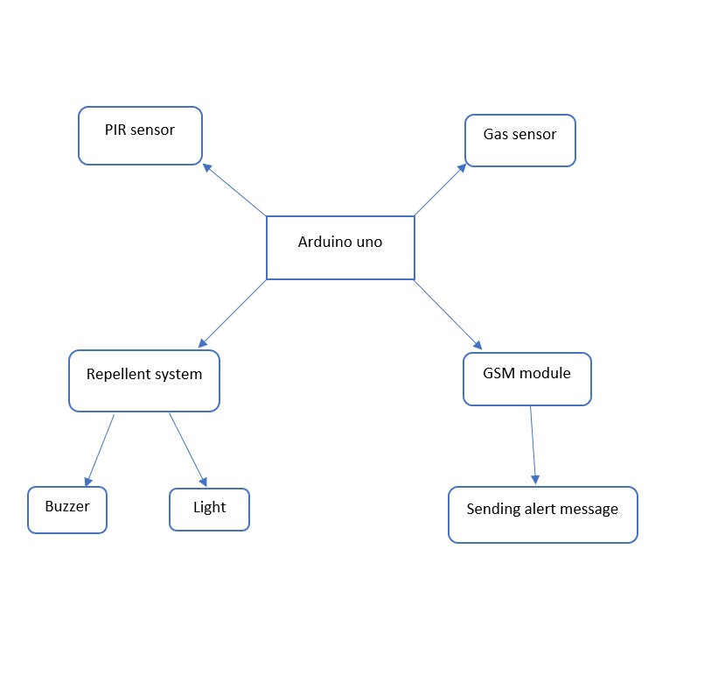
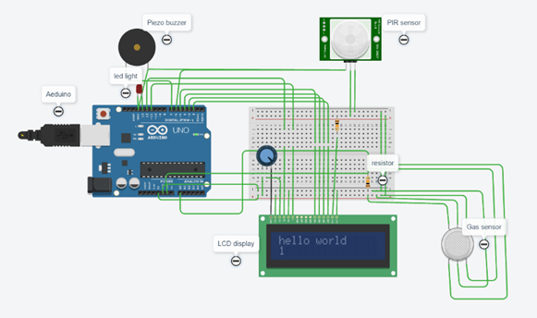
2. Crop protection from animals

Slide 7
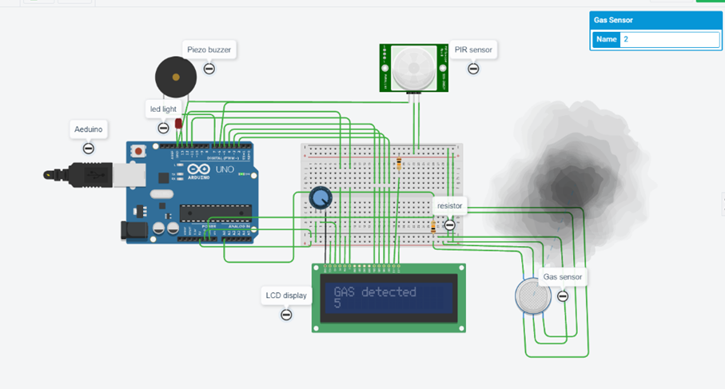
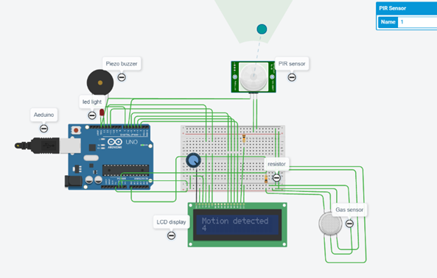
Result of simulation
Smoke detected
Motion detected

Slide 8
Conclusion
IoT is being used extensively to lessen the burden on humans. But it can also help other living beings to protect themselves from collisions and attacks. Crop issue can also be solved without harming them. As we can monitor them regarding health issues and other things, it will be helpful for the forests officers, doctors and higher authorities to look after it.
In this project I introduced two problem statements and the types of solutions for it. I did this simulation in tinker cad software and came to know how it works like sensors and its connections etc.,
Further I will make this project into simple one where one system can operate many kinds of issues that we are facing right now. I will make a prototype regarding this and try to make it as simple as possible and easy to operate in an enable cost.
THANK YOU

